Slide 1
Object detection all in one
All in one
All in one
Restricted

Slide 2
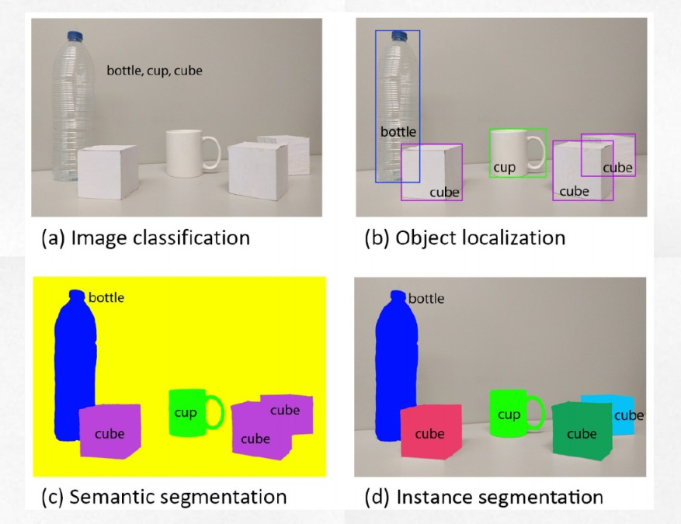
General computer vision tasks
Object recognition:
Object location:
Pixel-wise
Bounding box.

Slide 3
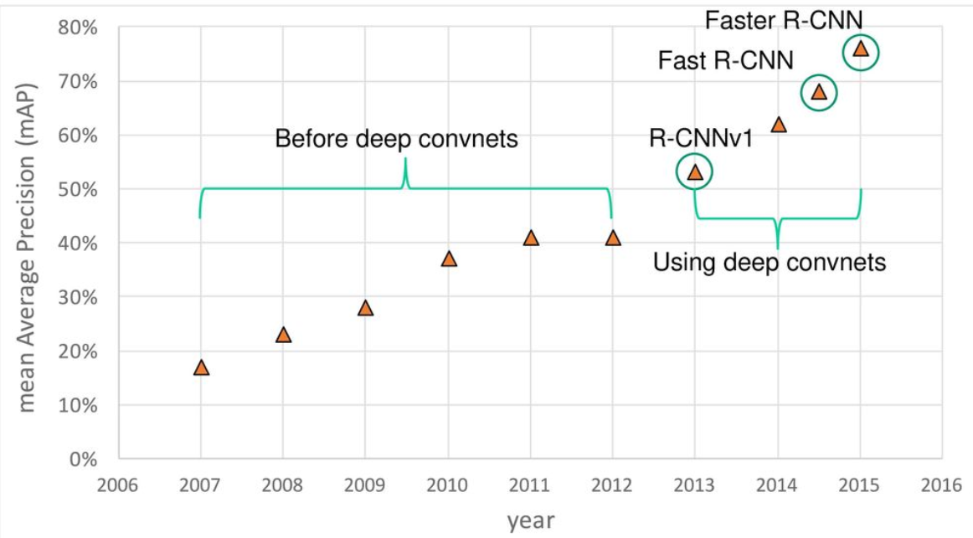
Non-deep to deep

Slide 4
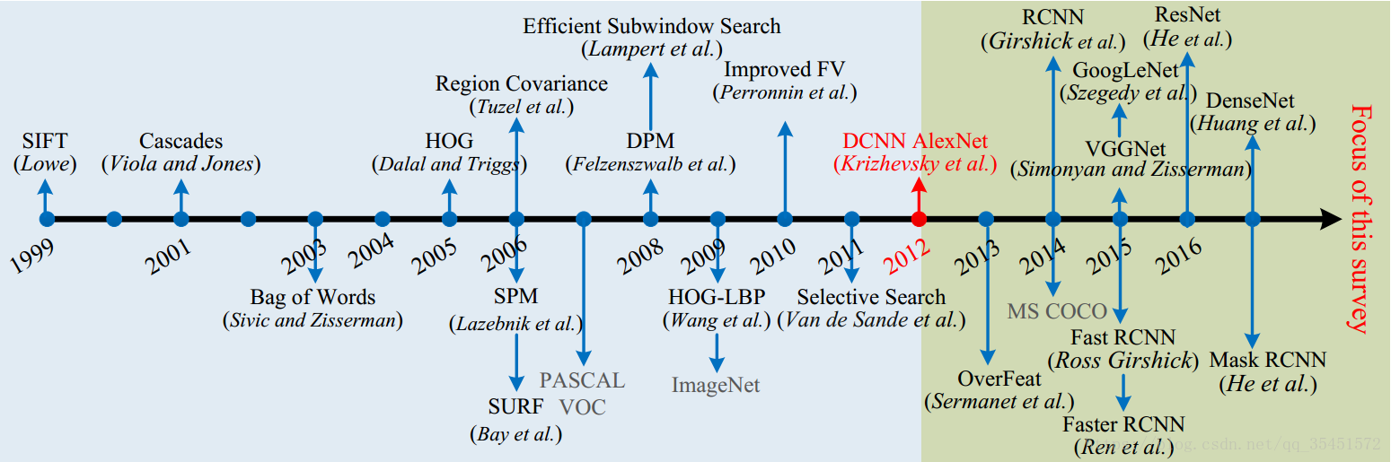
Non-deep to deep(algorithms details)

Slide 5
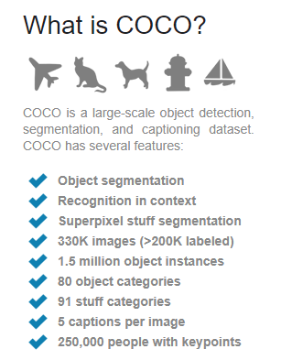
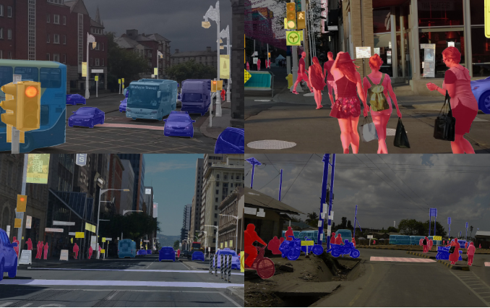
Datasets – COCO -- Detection
2019 new challenge: Joint COCO and Mapillary Recognition workshop at ICCV
https://research.mapillary.com/iccv19/

Slide 6
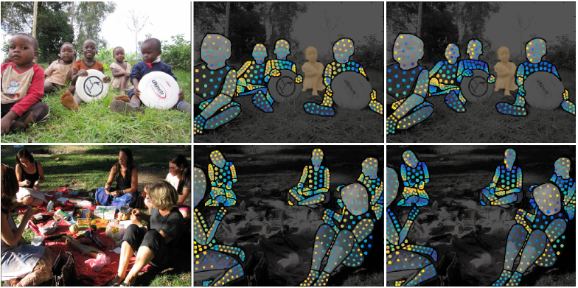
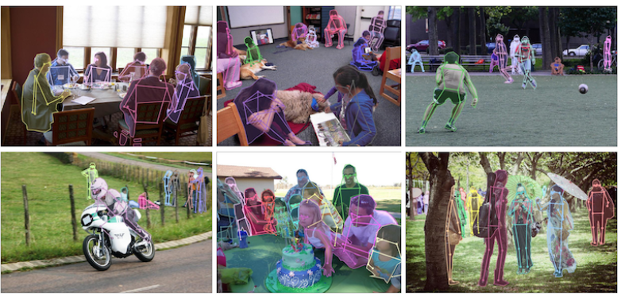
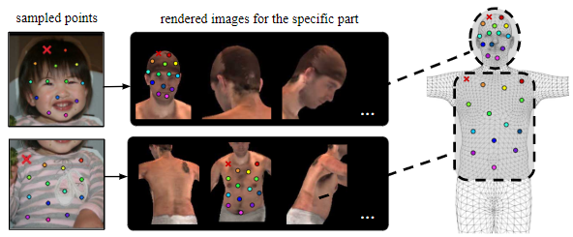
Datasets – COCO -- Others funny
The COCO DensePose Task requires localization of dense person keypoints in challenging, uncontrolled conditions. The DensePose task involves simultaneously detecting people and localizing their dense keypoints, mapping all human pixels to a 3D surface of the human body. For full details of this task please see the COCO DensePose Task.
The COCO Keypoint Detection Task requires localization of person keypoints in challenging, uncontrolled conditions. The keypoint task involves simultaneously detecting people and localizing their keypoints (person locations are not given at test time). For full details of this task please see the COCO Keypoint Detection Task.

Slide 7
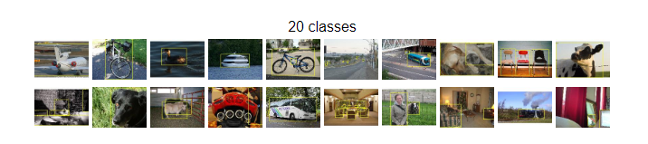
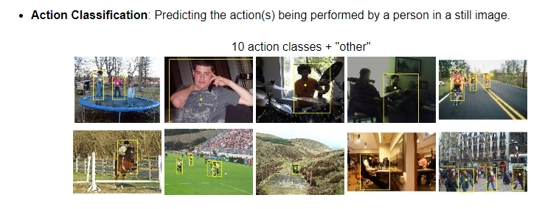
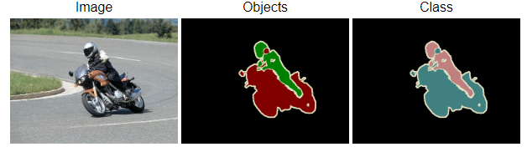
Datasets – PASCAL VOC

Slide 8
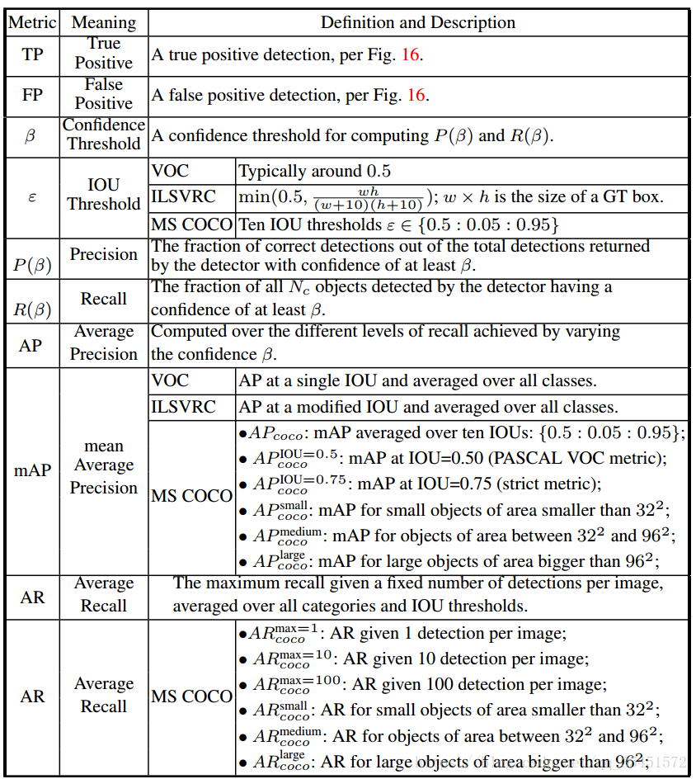
Evaluating
Intersection over Union: How the detection results overlap with ground truth
How many objects are detected, how is the accuracy of objects detected (recall/precision).

Slide 9
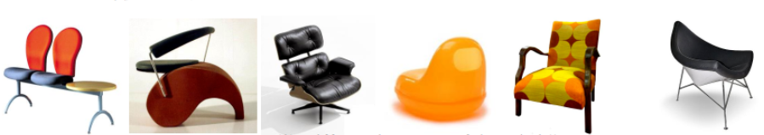
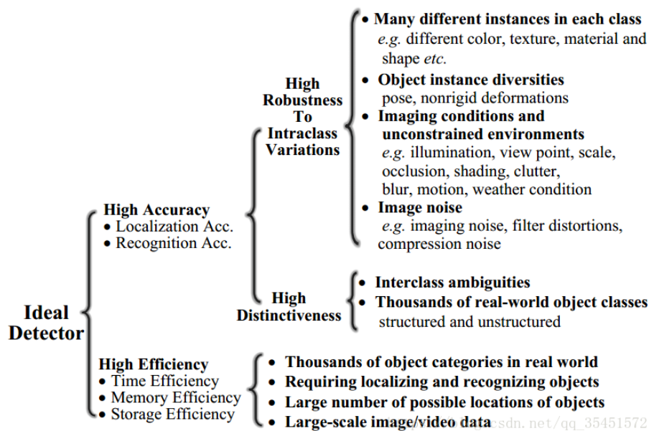
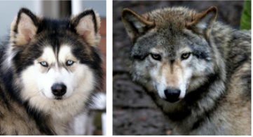
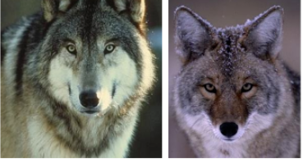
Challenge
Not unique for object detection

Slide 10

Traditional methods

Slide 11
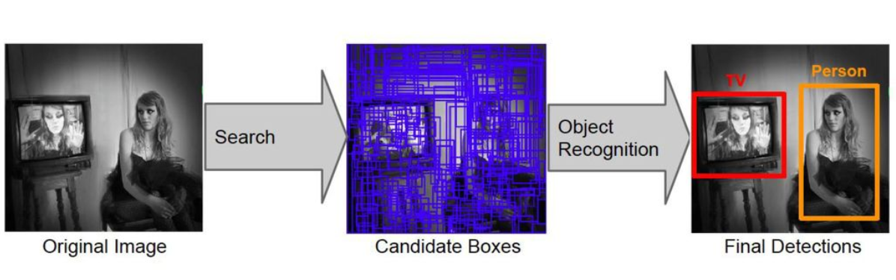
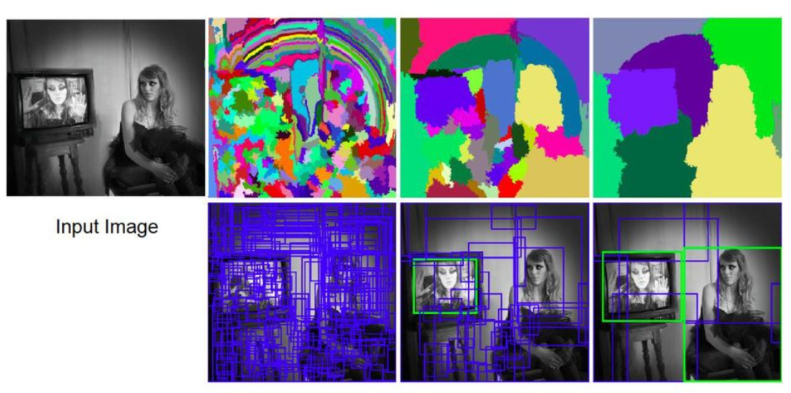
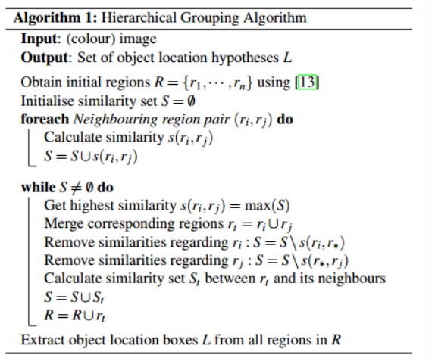
Selective Search

Slide 12
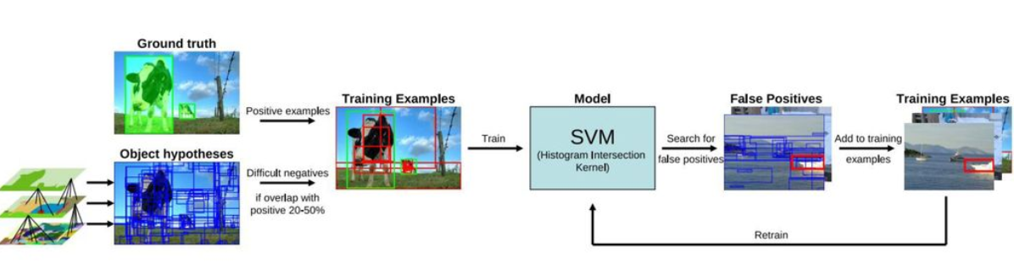
Selective Search -- pipeline
Training: Training classifier (SVM) combining with ground truth and false positive generated by selective search.
Inferencing: A traditional two stage method of generating bounding box first and then do classification parallelly within each region proposals.

Slide 13
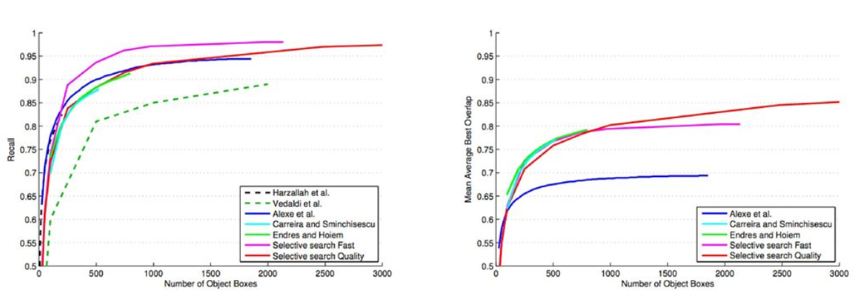
Non-deep region proposals

Slide 14
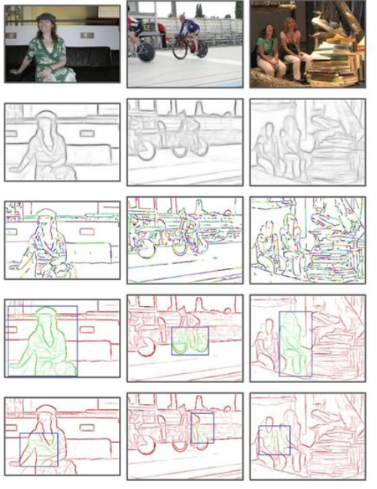
Another Proposal method: EdgeBoxes
Box score: number of edges in the box minus number of edges that overlap the box boundary.
-- A prior of objects with clusters of edges
-- Gets 74% recall with 800 boxes (vs. 1400 for Selective Search). Also 40 times faster.
Given a strong prior that objects candidates may be highly possible when edges sealing together.
It can be seen that traditional methods are all engaged of some sort of strong prior.

Slide 15
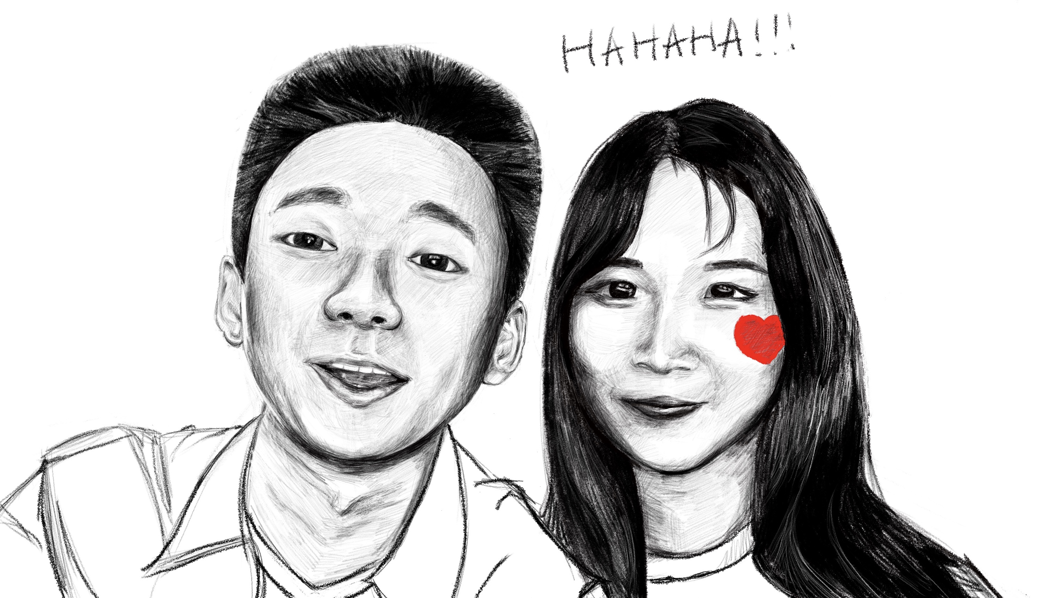
Step into novelty
Deep learning based methods give us a good accuracy

Slide 16
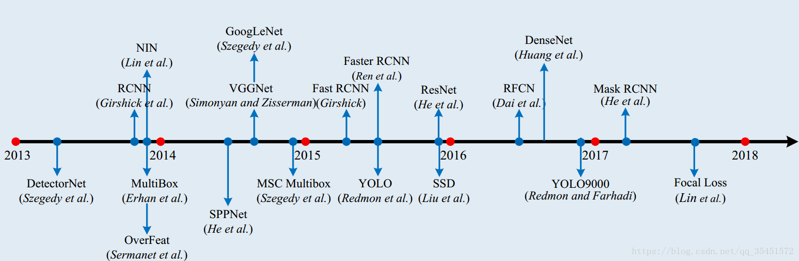
Deep learning(two stage and one stage) framework

Slide 17
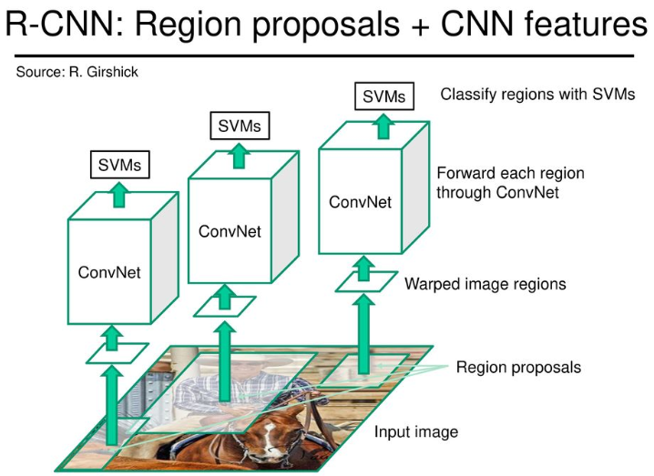
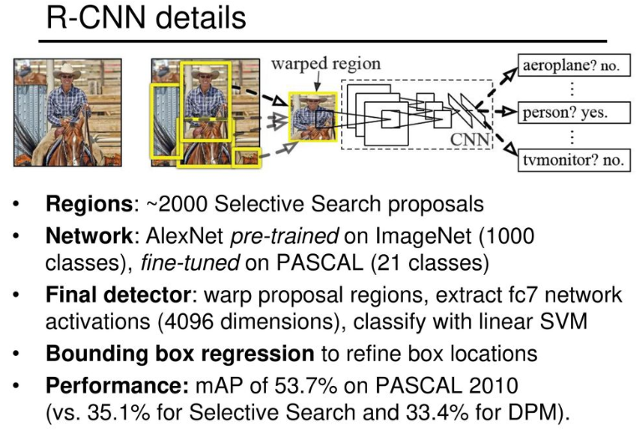
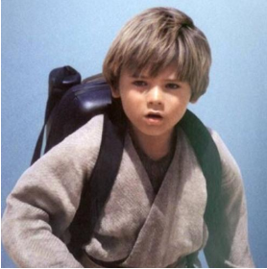
Two stage typical (The RCNN family)
Strat from an idea of taking advantage of CNN

Slide 18
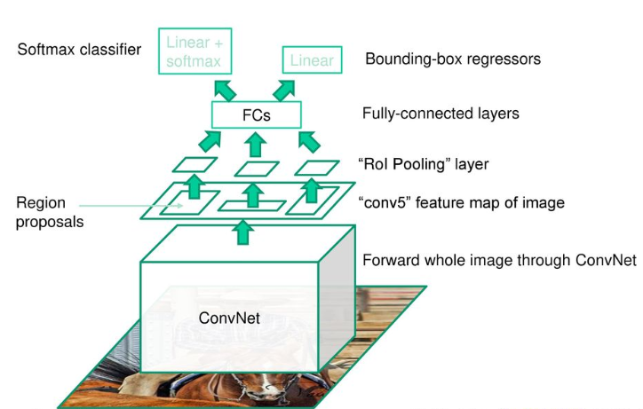
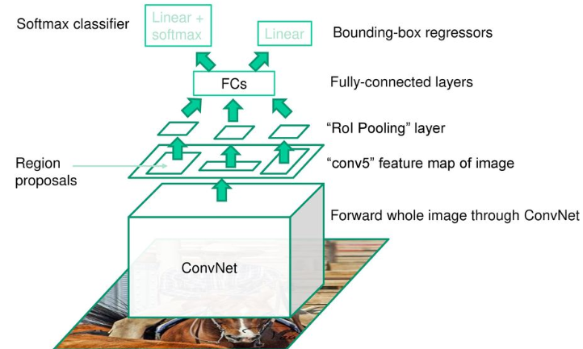
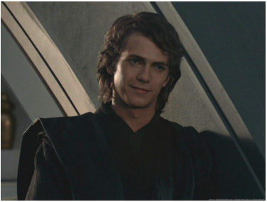
Two stage typical (The RCNN family)
Now we can do regression on the bounding box – We can modify the location of proposals during training

Slide 19
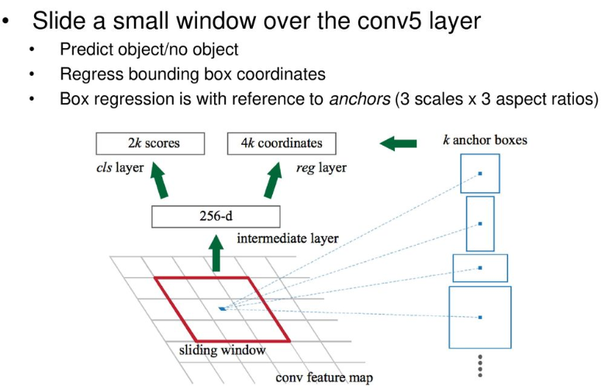
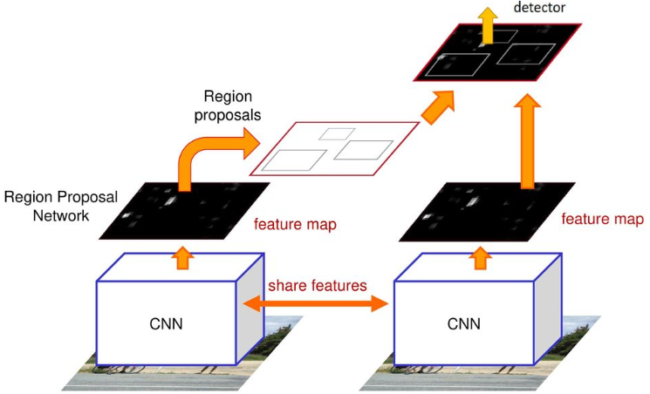
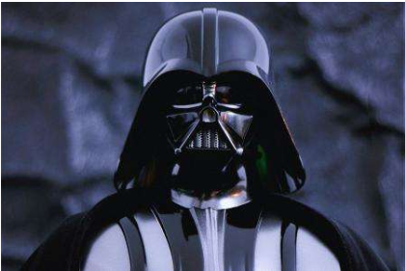
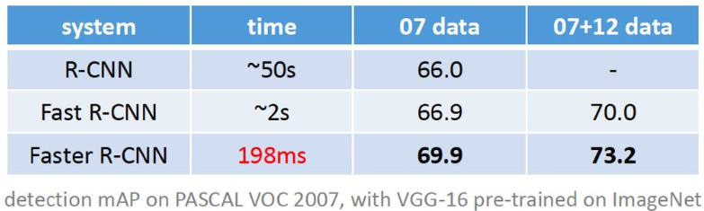
Two stage typical (The RCNN family)
Region Proposal Network
Faster RCNN structure
I am your father

Slide 20
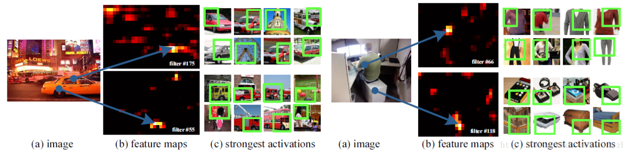
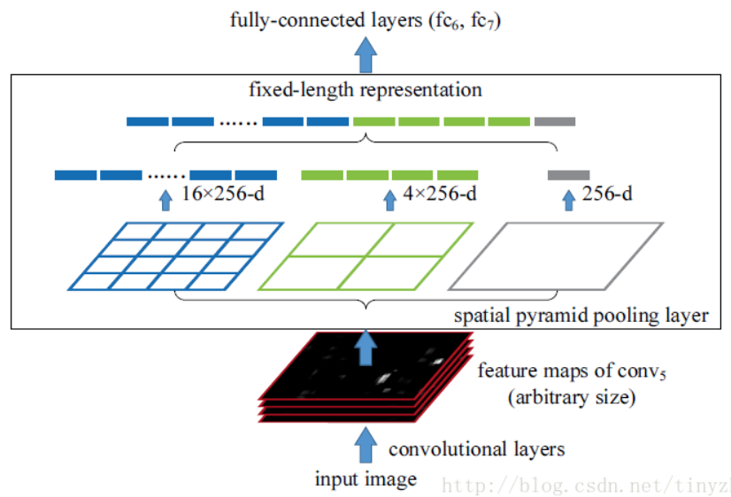
Other models followed on two-stage logic -- SPP net
Using SPP each window can get a fixed-size output, take this output into fully-connected layer, then the input picture can go through CNN only once.
Candidate of region proposal doing feature extraction process directly on the whole feature map, when training the feature extractor, we use pretrained weights by image classification, and freeze convolutional layer, fine-tune FCN layer on top.
After detection, it is the same with R-CNN, using SVM and bounding box regression. Input FC output as SVM feature and regression feature using SPP layer.

Slide 21
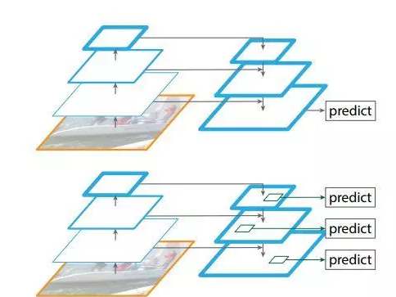
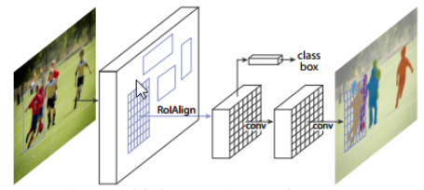
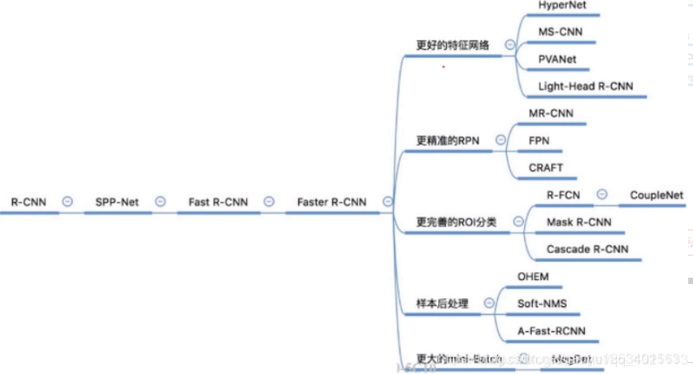
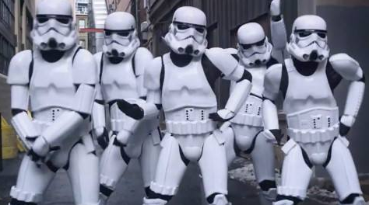
Other models followed on two-stage logic
Mask R-CNN
Feature Pyramid Network

Slide 22
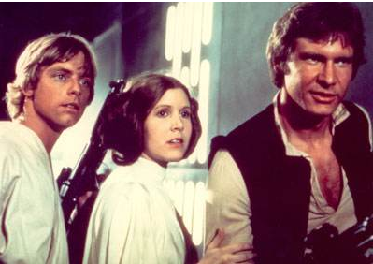
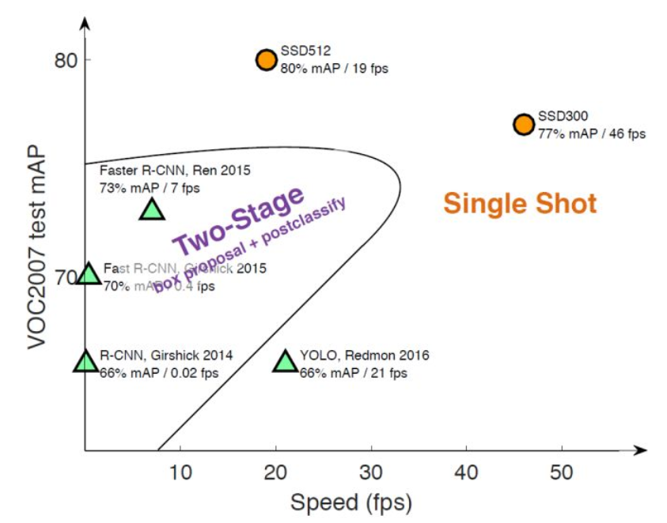
One-stage Detector
Though two-stage object detectors give us a good performance of object detection, but it has drawbacks:
Not friendly for real-time application.
Model often comes in a large size.
Longer training and inferencing time.
Two phase training (Not always, but the idea behind two-stage detector intuitively follows a way of two-stage training)
One stage: Adding prior bounding boxes

Slide 23
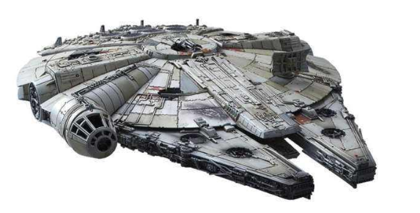
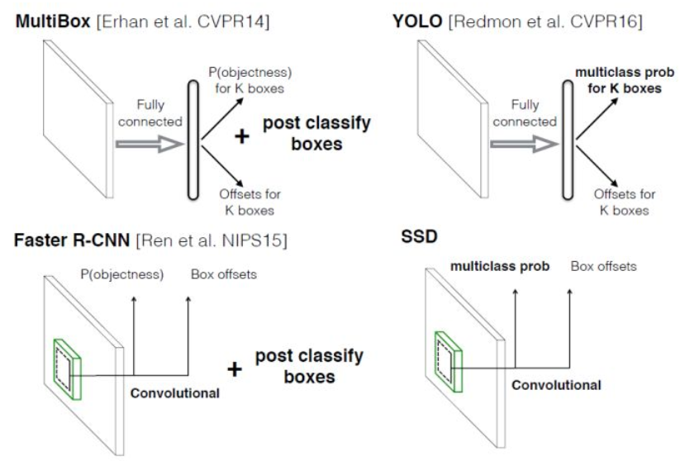
One-stage Detector – Anchor mechanism
Grids put a prior of location of objects, and anchors constrain the shape. Anchors are detector with different aspect ratios, perform as prior bounding boxes of detector.
Different anchor boxes settings between YOLO and SSD:
YOLO: Use k-means on training data, set the anchor boxes according to different data domain.(Since YOLO uses grids, thus prior anchor boxes do not contain information of location)
SSD: Manually set up anchor boxes in different scales (Prior anchor boxes have information of (x,y))

Slide 24
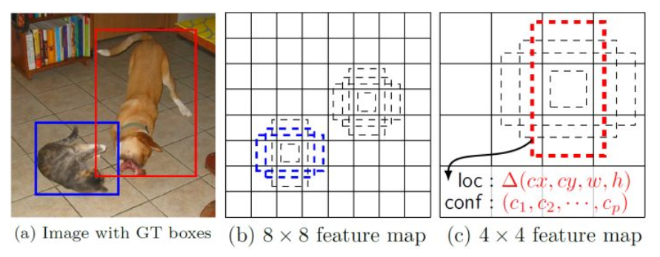
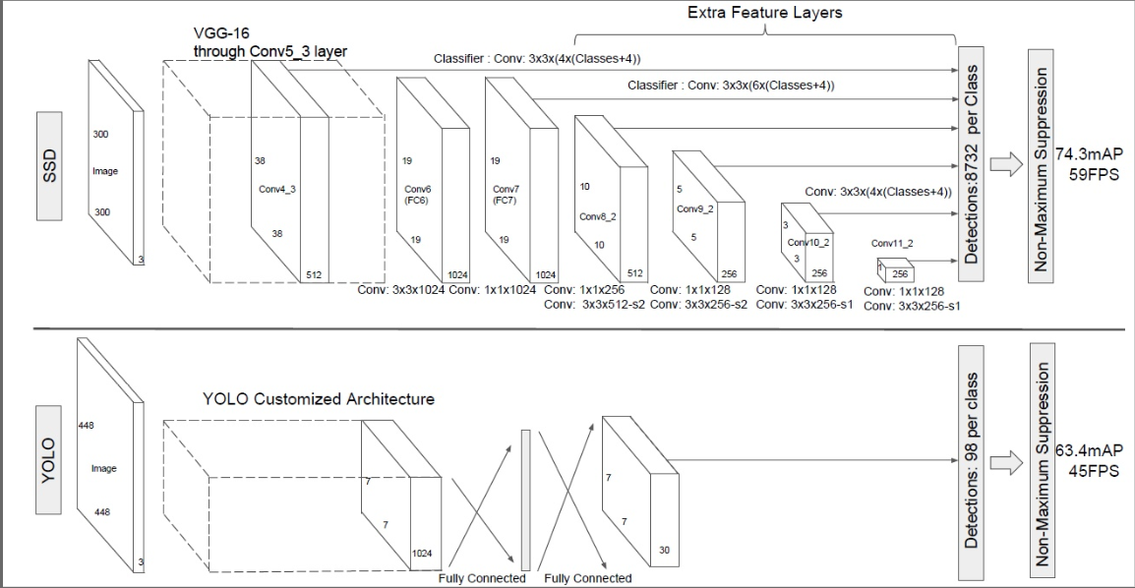
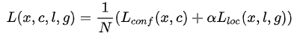
One-stage Detector -- SSD
Different scales of feature map take charge for detecting different size of objects.
Loss consists of two targets:
Minimize the classification error.
Modifying location of the pre-set bounding boxes

Slide 25
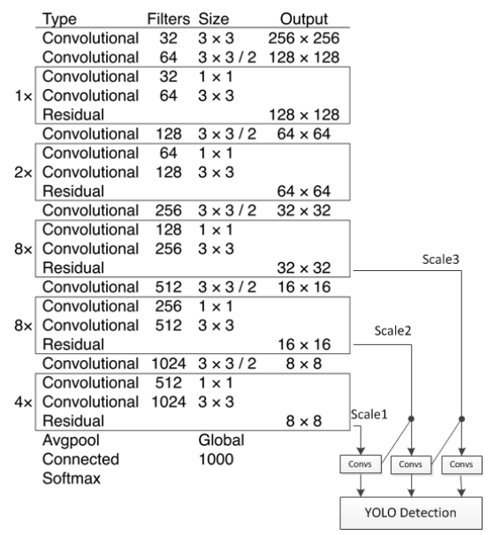
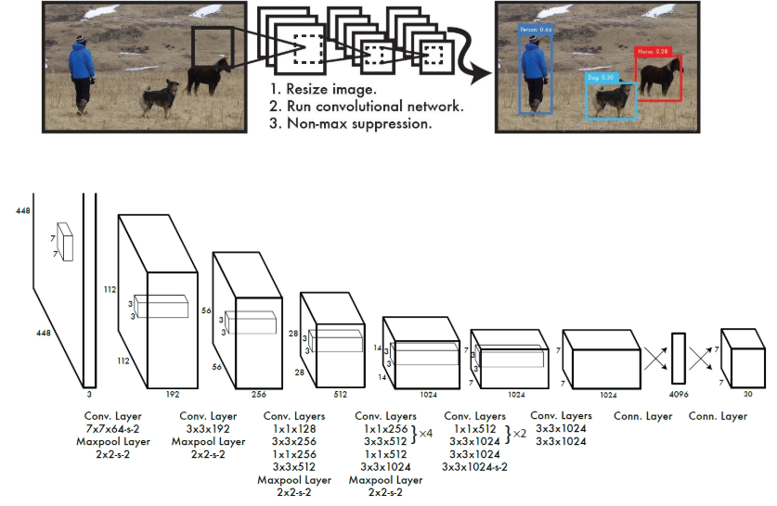
One-stage Detector -- YOLO

Slide 26
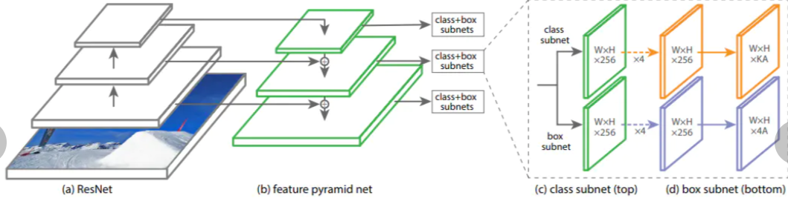



One-stage Detector – RetinaNet
Focal loss:
y’: Focus more on harder-classified samples(low confidence -> harder to distinguish)
Alpha: Making samples from less-amount classes more easy to get higher score.

Slide 27



Object detection – Others and The future
Combining with other techniques:
RNN: Image caption/OCR
Sequential analysis: Object tracking, video reasoning behavior
FSL/ZSL: Destiny
3D: Fate
Combining with other tasks:
Image Caption
Key-point detection
OCR
Trends:
Open worlding learning: MSCOCO, PSSCAL VOC, ImageNet offer limited classes for a human can recognize. Object detection involves of a large-scale supervised learning of CNN(feature extractor). Thus making FSL/ZSL valuable overall computer vision tasks.
Better and more efficient detection frameworks: Taking use of region-based detector.
Context reasoning.
Object instance segmentation
Weakly supervised/unsupervised learning.
3D object detection.

Slide 28

How we get this far?
How humanity seeing things? Location and Recognition
Two stage idea proposed corresponding to location and recognition:
Location: How we get region proposals? Strong prior of distributive pattern within a object is different with background.
Recognition: Go back to the tasks of image classification, where we can use ground truth and location results for data augmentation and domain stability.
Then we got deep learning, how we take advantage of deep learning?
Using its feature extracting ability for classification: RCNN.
Using its computational ability for regression together with 1.: Fast-RCNN
Two phase training is quite annoying: Faster-RCNN
Region proposal networks seem pretty good, why not we just propose plenty of prior anchor boxes, and then select them or abandon them?(object or not)
Then we got one stage detector.
Motivations:
Shared wrights among tasks (object detection and image classification)
Proposal of priors into machine learning tasks, and make them well-structured and differentiable.
Application and engineering requirements.
https://github.com/hoya012/deep_learning_object_detection#2014

